Slide 1
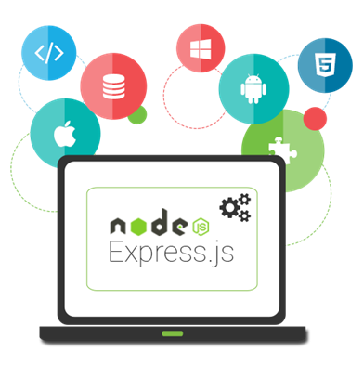
Intro to Express.js and View Engines
Router, Static Files, Middleware, Handlebars
SoftUni Team
Technical Trainers
Software University
https://softuni.bg

Slide 2
Table of Contents
Express
Introduction
Router
Middleware
Static Files
View Engines
Templating Concepts
Handlebars

Slide 3
Have a Question?
sli.do #js-web

Slide 4
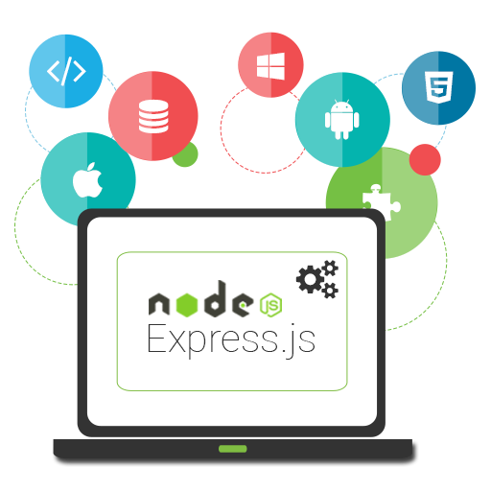
Introduction to Express.js

Slide 5
Introduction to Express.js
npm install express
const express = require('express')
const app = express();
const port = 3000;
app.get('/', (req, res) => {
res.status(200);
res.send('Welcome to Express.js!');
})
app.listen(port, () => console.log(`Express running on port: ${port}...`));
Create a new instance of the application

Slide 6
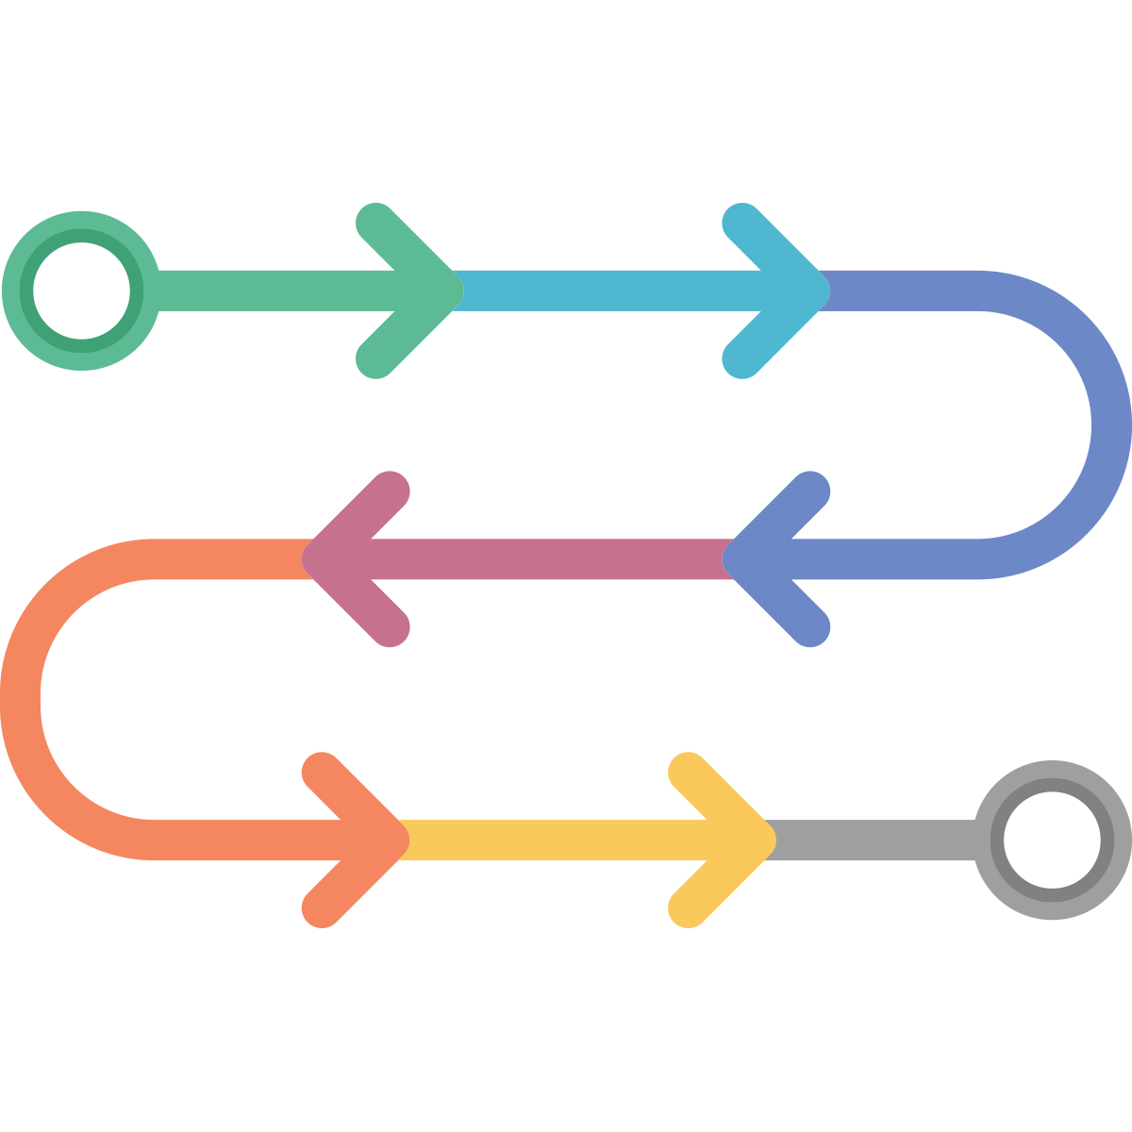
Router in Express.js

Slide 7
Router
Routing has the following syntax
Where
app is an instance of express
METHOD is an HTTP request method, in lowercase
PATH is a path on the server
HANDLER is the function executed when the route is matched
app.METHOD(PATH, HANDLER)

Slide 8
Route Methods
// GET method route
app.get('/', (req, res) => {
res.send('GET request to the homepage')
})
// POST method route
app.post('/', (req, res) => {
res.send('POST request to the homepage')
})
// PUT method route
app.put('/', (req, res) => {
res.send('PUT request to the homepage')
})

Slide 9
Route Methods
// All methods route
app.all('/about', (req, res, next) => {
console.log('Middleware execution..')
next()
}, (req, res) => {
res.send('Show about page.')
})
The next handler to be called
Shows the about page after middleware execution

Slide 10
Router Paths
Paths can contain special characters:
app.get('*',(req, res) => {
res.send('Matches everything')
})
app.get('/ab*cd', (req, res) => {
res.send('abcd, abANYTHINGcd')
})
app.get(/.*fly$/, (req, res) => {
res.send('butterfly, dragonfly') })
Based on string patterns
Based on regular expressions

Slide 11
Extracting Parameters
Paths can have parameters
You can also validate parameters with regular expressions (it is not recommended)
app.get('/users/:userId', (req, res) => {
const paramsObj = req.params
res.send(paramsObj) })
app.get('/users/:userId(\\d+)', (req, res) => {
const paramsObj = req.params
res.send(paramsObj) })

Slide 12
Chainable Routes
You can create chainable route handlers using 'app.route()'
app.route('/home')
.get((req, res) => {
res.send('GET home page') })
.post((req, res) => {
res.send('POST home page') })
.all((req, res) => {
res.send('Everything else')
})
Better for ordering routes
Always place 'all' as a final method

Slide 13
Router Responses
Responses
res.download - prompt a file to be downloaded
res.end - end the response process
res.json - send a JSON response
app.get('/pdf', (req, res) => {
res.download('FULL PATH TO PDF') })

Slide 14
Router Responses
res.redirect - redirect a request (to another page)
res.sendFile - send a file as an octet-stream
res.render - render a view template
app.get('/about/old', (req, res) => {
res.redirect('/about') })
app.get('/file/:fileName', (req, res) => {
const fileName = req.params.fileName
res.sendFile("PATH TO FILE" + fileName) })

Slide 15
Modular Routers
You can use express.Router for modular route handlers
Mounted on a route (e.g. '/about')
Can use middleware, specific only to that router
const express = require('express')
const router = express.Router()
router.use(/* add middleware */)
router.get(/* define route handlers */)
app.use('/about', router)

Slide 16

Middleware

Slide 17
Middleware
Function that has access to
The request and response object
The next middleware in the application's request-response cycle
Different kinds of middleware exist
Application, route, error
const app = express()
app.use((req, res, next) => {
console.log('Time:', Date.now())
next() })
Next handler to be called

Slide 18
Custom Middleware
Middleware can be for specific path
app.use('/user/:userId', (req, res, next) => {
const userId = req.params.userId
// TODO: Check if user exists in db/session
let userExists = true
if (!userExists) { res.redirect('/login') }
else { next() } })
app.get('/user/:userId', (req, res) => {
res.send('User home page!')
})

Slide 19
Custom Middleware
Can be on Application-level:
Can be used for error-handling
app.use(function (req, res, next) {
console.log('Time:', Date.now()) next()
});
app.use(function (err, req, res, next) {
console.error(err.stack)
res.status(500).send('Something broke!')
});

Slide 20
Third-Party Middleware
app.set('view engine', 'pug');
app.set('views', __dirname + '/views');
app.use(cookieParser());
app.use(session({secret: 'magic unicorns'}));
app.use(passport.initialize());
app.use(passport.session());
app.use(express.static(config.rootPath +'/public'));

Slide 21
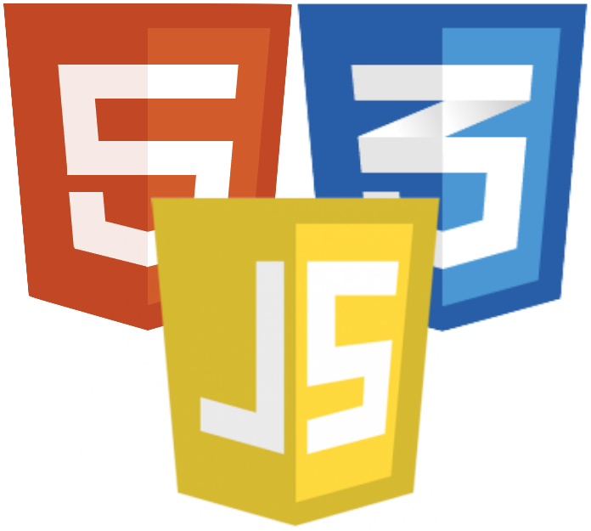
Static Files

Slide 22
Static Files
Serving static files
And all files from the directory will be public
app.use(express.static('public'))
app.use('/static', express.static('public'))
app.use('/static', express.static(__dirname + '/public'))
http://localhost:3000/images/kitten.jpg
http://localhost:3000/css/style.css
http://localhost:3000/js/app.js
http://localhost:3000/images/bg.png
http://localhost:3000/hello.html

Slide 23

Templating Concepts

Slide 24
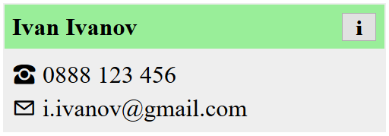

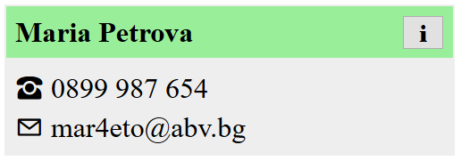
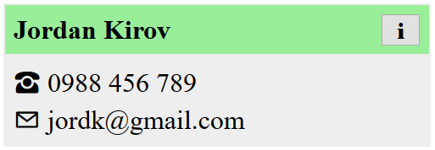
Templating
Allows similar content to be replicated in a web page, without repeating the corresponding markup everywhere
HTML
<div>
<span>
<button>
Dynamic
Ivan,
Maria,
Jordan

Slide 25
Templating Concepts
The static parts of a webpage are stored as templates
The dynamic content is kept separately (e.g. in a database)
A view engine combines the two
Benefits
Productivity - avoid writing the same markup over and over
Easier upkeep - only change the code in one place
Composability - a single element can be used on multiple pages

Slide 26

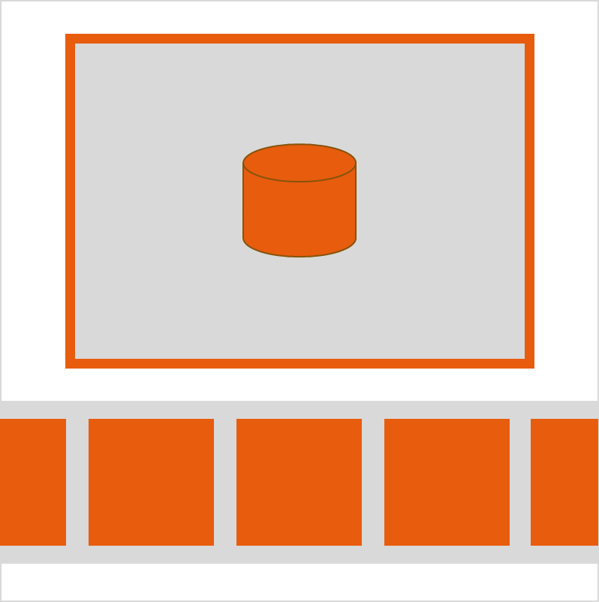
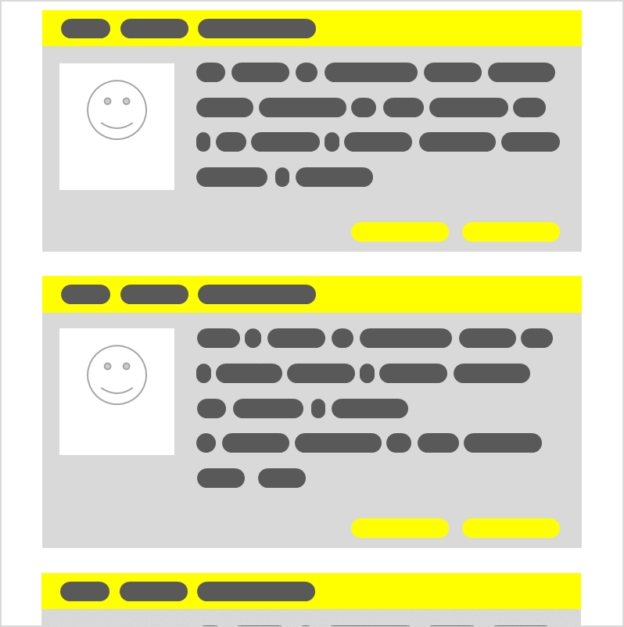
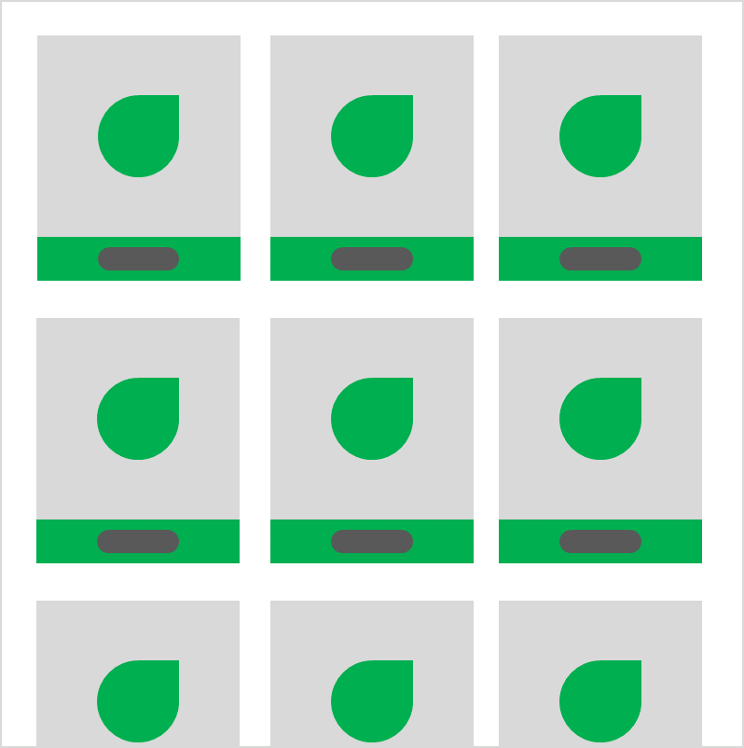
Examples
Display articles in a blog
Display a gallery of photos
Visualize user profiles
Show items in a catalog

Slide 27
Server View Engines
Server view engines return ready-to-use HTML to the client (the browser)
They parse the data to HTML on the server
Web applications, created with server view engines are not real SPA apps (In most cases)
Famous View Engines
Pug, Mustache, Handlebars, EJS, Vash

Slide 28

Templating with Handlebars

Slide 29
Handlebars
Based on Mustache specification
Expressions are initialized with '{{' and finish with '}}'
<div class="entry">
<h1>{{title}}</h1>
<div class="body">
{{body}}
</div>
</div>
<div class="entry">
<h1>My New Post</h1>
<div class="body">
This is my first post!
</div>
</div>

Slide 30
Integration in Express
npm install express-handlebars
const app = require('express')()
const handlebars = require('express-handlebars')
app.engine('.hbs', handlebars({
extname: '.hbs'
}))
app.set('view engine', '.hbs')
Set file extension
app.get('/', function (req, res) {
res.render('home');
})
Call the template

Slide 31
Handlebars directory structure
Must have a views folder containing all the Handlebars templates:
The layouts folder inside the views folder will contain the layouts or the template wrappers.
The main.hbs file is the main layout.
Note: The default name of the folders can be changed with an appropriate setting
└── views
└── layouts
└── main.hbs
By Default

Slide 32
For-Loops
A template can be repeated for every entry in an array
const context = {
contacts: [
{ name: 'Maria Petrova', email: 'mar4eto@abv.bg'},
{ name: 'Jordan Kirov', email: 'jordk@gmail.com'} ]};
<ul id="contacts">
{{#each contacts}}
<li>{{name}}: {{email}}</li>
{{/each}}
</ul>
The expression inside
the loop uses each
entry as context

Slide 33
Conditional Statements
{{#if sunny}}
The sky is clear
{{else}}
The sky is overcast
{{/if}}
Variable to check
for truthiness
<ul id="contacts">
{{#each contacts}}
<li>{{name}}: {{email}}</li>
{{else}}
<i>(empty)<i>
{{/each}}
</ul>
Will be shown if
the array is empty

Slide 34
Partials
Templates that can be inserted into other templates
<div id="contacts">
{{#each contacts}}
{{> contact}}
{{else}}
<i>(empty)<i>
{{/each}}
</div>

Slide 35
HTML Escaping
By default, any strings that are evaluated will be HTML-escaped
To prevent this, use the "triple-stash"
title: "All about <p> Tags"
body: "<p>This is a post about &lt;p&gt; tags</p>"
<h1>{{title}}</h1>
<div class="body">
{{{body}}}
</div>
<h1>All About &lt;p&gt; Tags</h1>
<div class="body">
<p>This is a post about &lt;p&gt; tags</p>
</div>

Slide 36

Summary
…
…
…
Express.js is a fast web framework for Node.js
Middlewares can manipulate requests and responses
Templates speed up and simplify development
View Engines render templates
Handlebars offers effective templates and simple helper functions

Slide 37
Questions?
Notes:
37

Slide 38










SoftUni Diamond Partners

Slide 39



Educational Partners

Slide 40
Trainings @ Software University (SoftUni)
Software University – High-Quality Education, Profession and Job for Software Developers
softuni.bg
Software University Foundation
softuni.foundation
Software University @ Facebook
facebook.com/SoftwareUniversity
Software University Forums
forum.softuni.bg
Notes:
40

Slide 41

License
This course (slides, examples, demos, exercises, homework, documents, videos and other assets) is copyrighted content
Unauthorized copy, reproduction or use is illegal
© SoftUni – https://about.softuni.bg/
© Software University – https://softuni.bg
Notes:
41

